Slide 1


Proposal and Feasibility Presentation Template
Mobile App For Personal Finance:
Muhammad Bilal, FA14-BSE-108
Khizer Jadoon, FA14-BSE-110
Sirat Ahmad, FA14-BSE-104
Supervisor
Dr. Waqas Jadoon
1
Department of Computer Science
COMSATS Institute of IT, Abbottabad

Slide 2
Agenda of the Presentation
Motivation
Brief Introduction
Scope
Functionalities
Proposed tools
Feasibility
Schedule

Slide 3
Motivation
People tend to spend money without planning and end up wasting more money than they would have wanted
This app would help its users to spend wisely and provide them an insight on where they are spending their money

Slide 4
Brief Introduction
This system is about to facilitate people and provide accurate results according to daily expenditures
In this project, the aim is to implement a handy mobile app to keep track of daily or significant expenditure in daily life
Through which we can easily make an accurate decision according to our previous saved data of expenditures

Slide 5
Scope
We would create an android app which will allow the user to handle and analyze his daily expenses
The app would use image recognition to read the data from receipts
The app would store the expenses over a period of time and display the reports
We will provide 3 formats of receipts for extracting the expenditure data

Slide 6
Functionalities
The project would be a mobile app which would include the following modules:
1. Receipt recognition module
This module would be responsible to extract the data from images of receipts taken by the user
2. Alert module
This module would be responsible for monitoring the user’s expenses and alerting the user whenever the expenses approach or exceed the maximum limit set by the user.

Slide 7
Functionalities
3. Report Generation module
This module would be responsible to generate a report based on the user’s expenses in the current month or week (as specified by the user).
4. Manually add module
This module is responsible to add data manually with the help of user.

Slide 8
Proposed Tools/Platform
Tools:
Android Studio
SQLite
Tesseract (OCR)
Platforms:
Android

Slide 9
Feasibility
Technical feasibility
Tesseract (OCR) :
Free API for extracting information from images of receipt
Smart Phone:
For running the android application
Android Studio (Latest Version):
For android application

Slide 10
Feasibility
Financial feasibility
Resource Name | Price | Source
Laptop x3 | 120,000 | Bought
Mobile | 15,000-20,000 | Available
Android Studio | Open source | Android. Developer
Tesseract(OCR) | Open source | github.com
SQLite | Available | www.Microsoft.com
Sponsors/funding source |  | self

Slide 11
Feasibility
Resource feasibility
Android Studio (Latest Version)
SQLite
Tesseract(OCR)
These all resources are easily available.

Slide 12
Feasibility
Operational feasibility
This project is based on the daily expenditure and provide accurate results according to daily expenditures
This project will run on most android phones easily by only downloading it from the play store

Slide 13
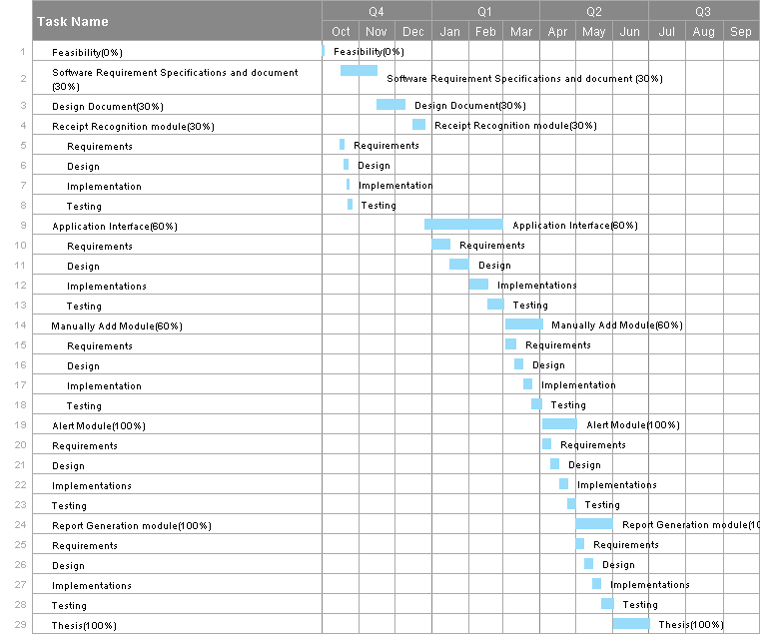
Schedule
Gantt Chart (using OpenProj or OpenProject [https://www.openproject.org/])

Slide 14
Tasks for 1st Iteration (or 30%)
SRS Documentation
Design Documentation
Receipt Recognition module

Slide 15
Conclusion
The objective of this presentation is to get approved our project according to its feasibility study considering the all points mentioned above

Slide 16
Thank you!

